Slide 1
PREDICTIVE MODELING FOR ATTORNEY INVOLVEMENT IN CLAIMS

Slide 2
PROBLEM STATEMENT
Attorney involvement in claims leads to increased legal costs.
Predicting attorney involvement can help insurance companies
manage claims more effectively.
Need for an efficient model to classify claims based on various factors.

Slide 3
DATASET DETAILS
COLUMN NAMES | DESCRIPTION
CASENUM | A unique identifier assigned to each claim case for reference and tracking purposes.
ATTORNEY | Indicates whether an attorney was involved in handling the claim. [1 = Attorney involved , 0 = No attorney involved]
CLMSEX | Gender of the claimant. [1 = Male , 0 = Female]
CLMINSUR | Specifies whether the claimant was insured at the time of the accident. [1 = Insured, 0 = Not insured]
SEATBELT | Indicates if the claimant was wearing a seatbelt at the time of the accident. 1 = Wore a seatbelt , 0 = Did not wear a seatbelt
CLMAGE | Represents the age of the claimant at the time of the claim.

Slide 4
COLUMN NAMES | DESCRIPTION
LOSS | The financial loss incurred due to the claim . This may include medical expenses, vehicle damage, or other costs.
ACCIDENT SEVERITY | The severity level of the accident. [Minor , Moderate , Severe]
CLAIM AMOUNT REQUESTED | The initial amount requested by the claimant as compensation for the claim
CLAIM APPROVAL STATUS | Indicates whether the claim was approved or denied. [1 = Approved ,0 = Denied]
SETTLEMENT AMOUNT | The final amount that was paid to the claimant after claim processing and negotiations.
POLICY TYPE | Specifies the type of insurance policy held by the claimant. [1= Comprehensive, 0= Third-Party]
DRIVING RECORD | The claimant’s driving history, indicating past traffic violations or offenses. [Clean , Minor Offenses , Major Offenses].

Slide 5
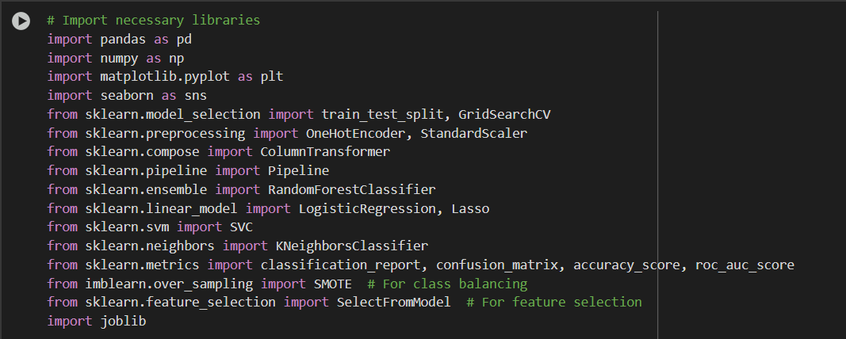
Importing Necessary Libraries

Slide 6

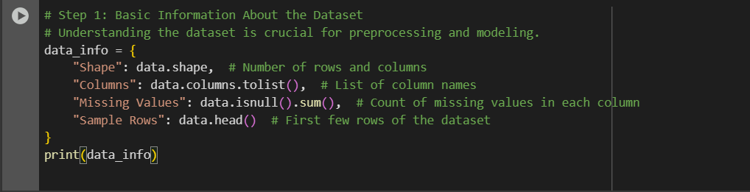
Load the Dataset
Dataset Name: Updated_Claimants_Dataset.csv.
Exploring the Dataset

Slide 7
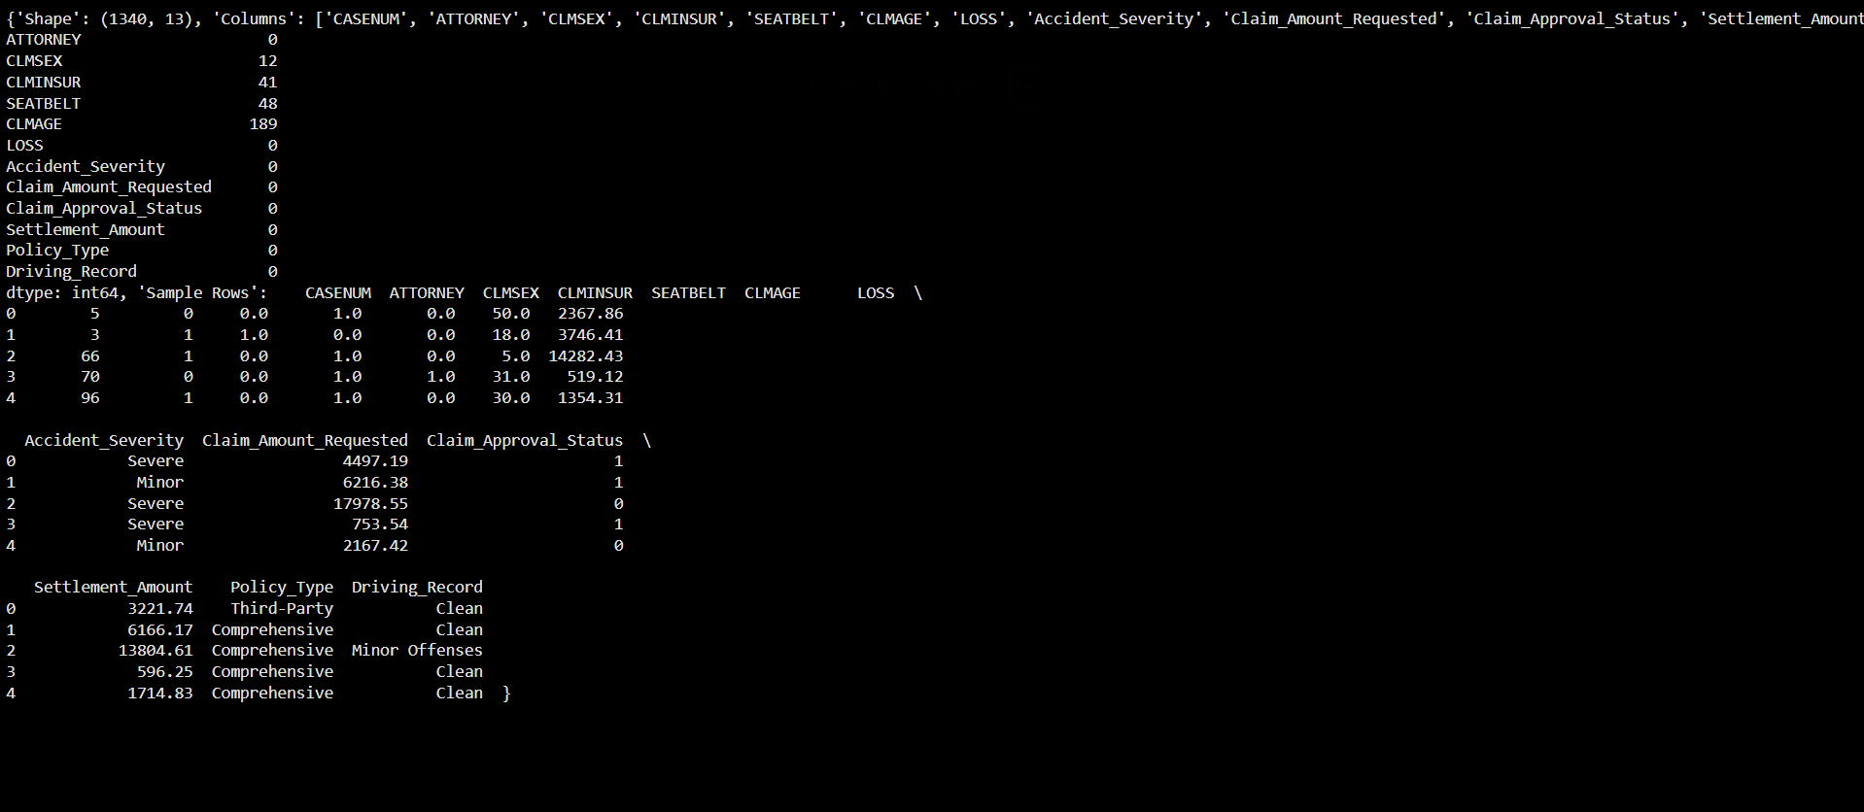

Slide 8
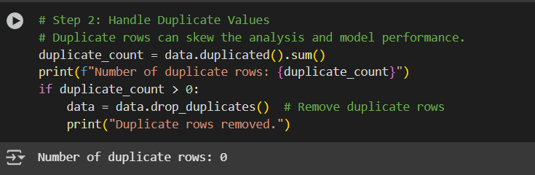
Handling Duplicate Values

Slide 9
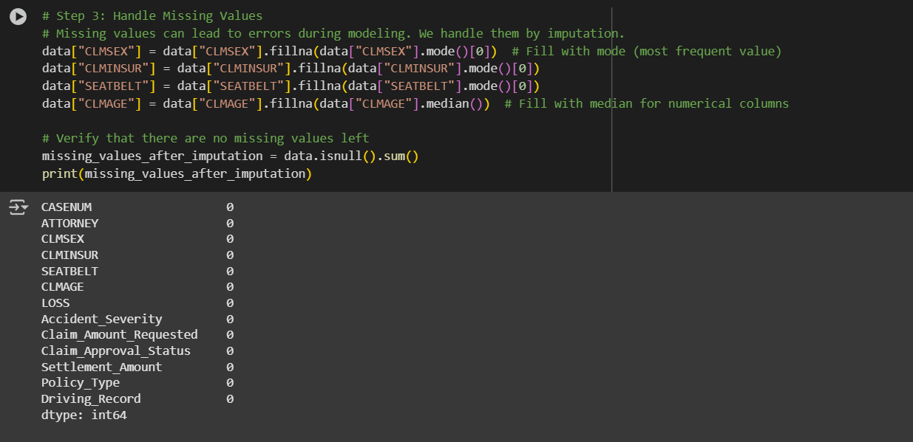
Handling Missing Values

Slide 10
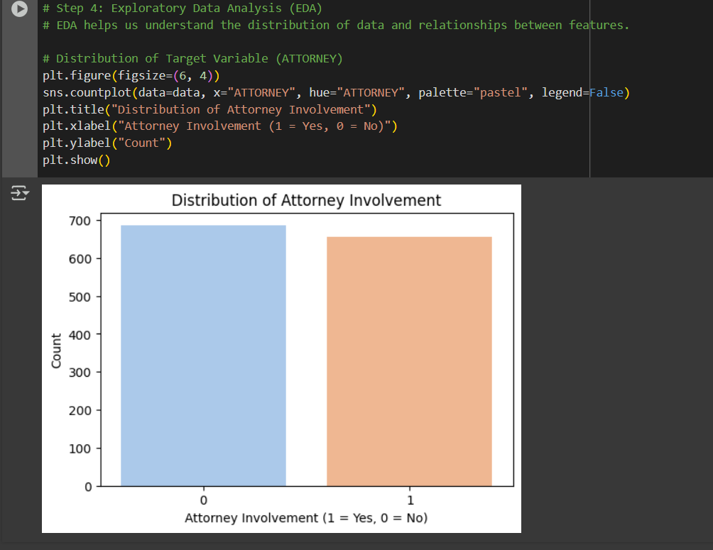
Exploratory Data Analysis (EDA)

Slide 11
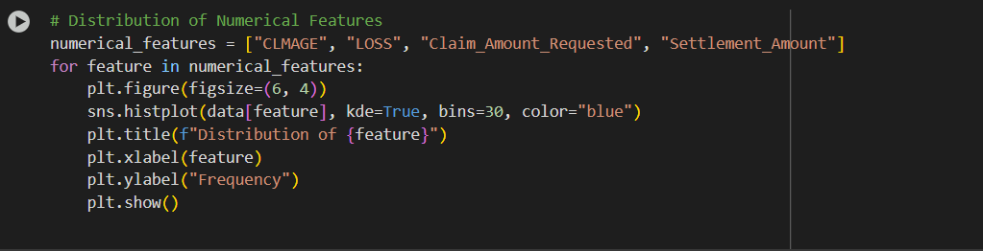
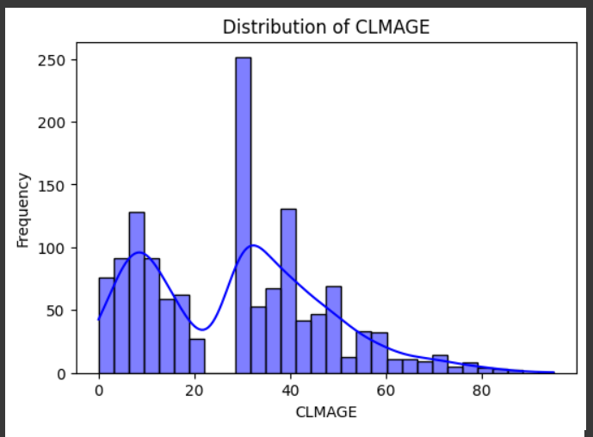

Slide 12
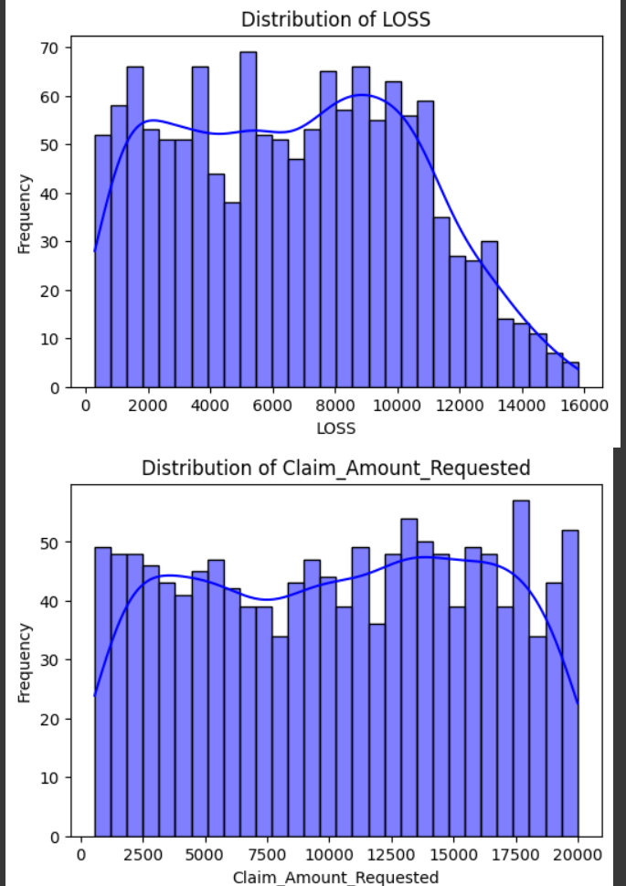

Slide 13
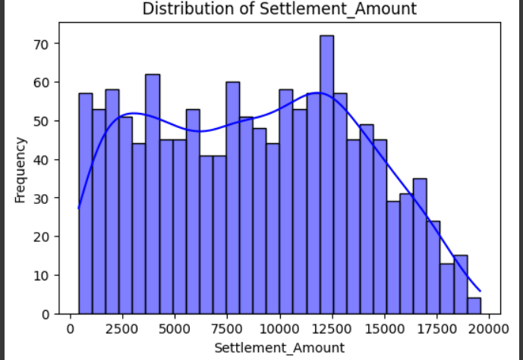

Slide 14
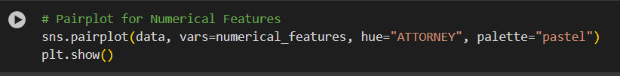
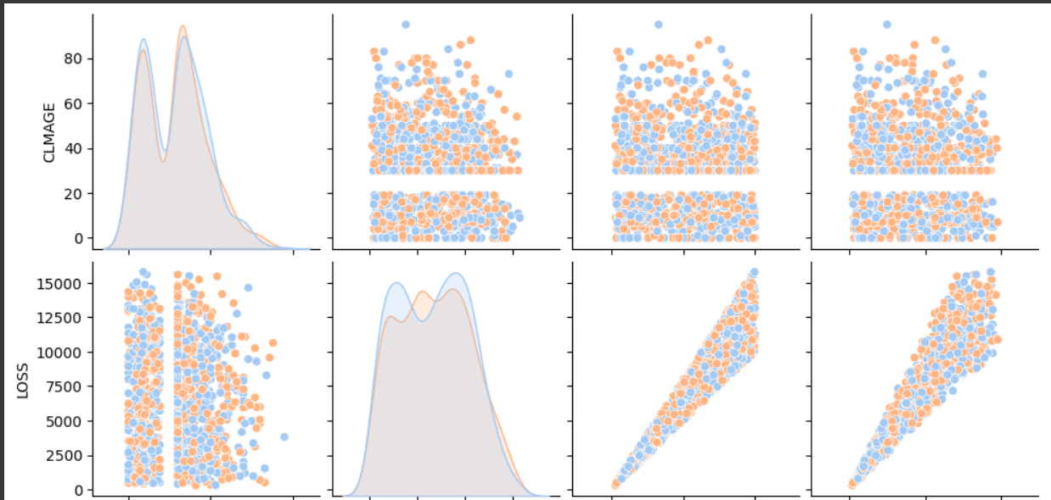

Slide 15
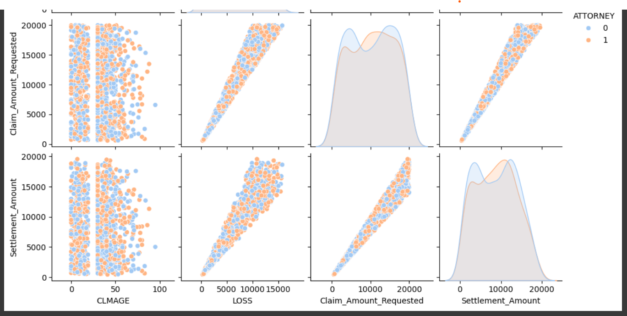

Slide 16
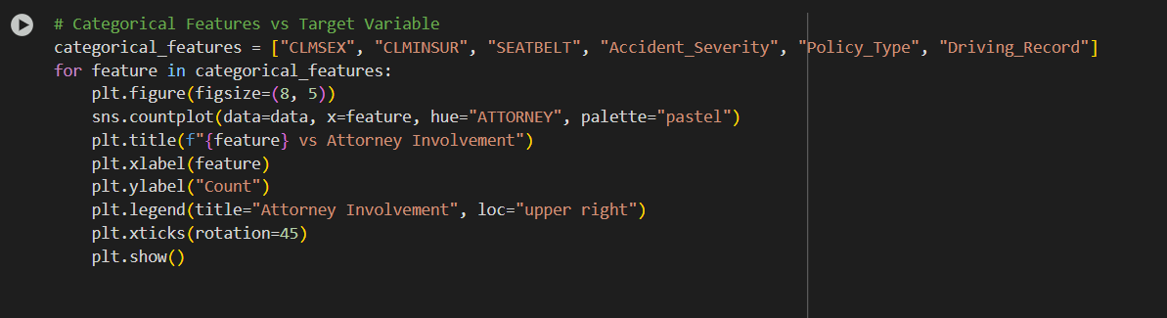

Slide 17
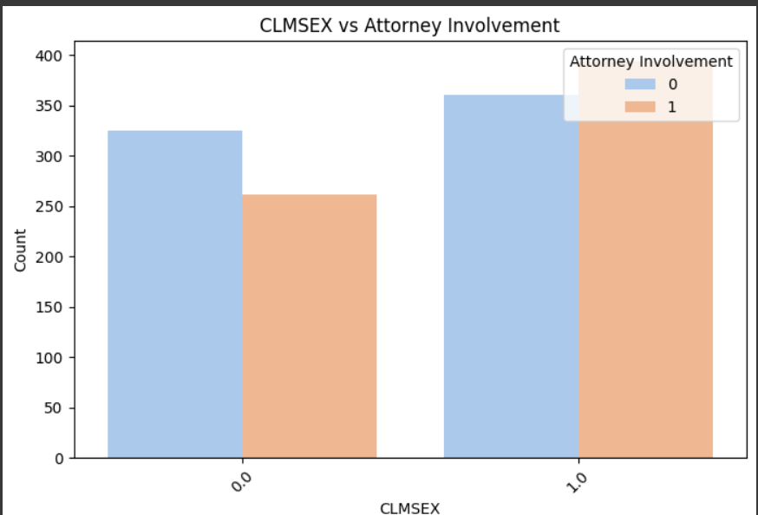
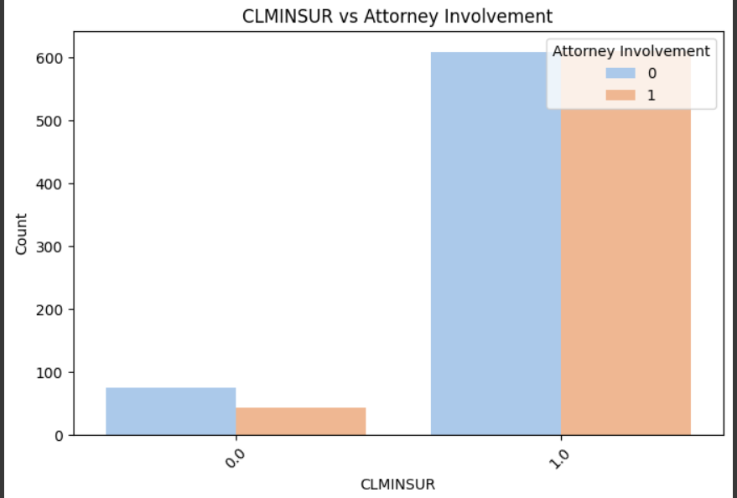

Slide 18
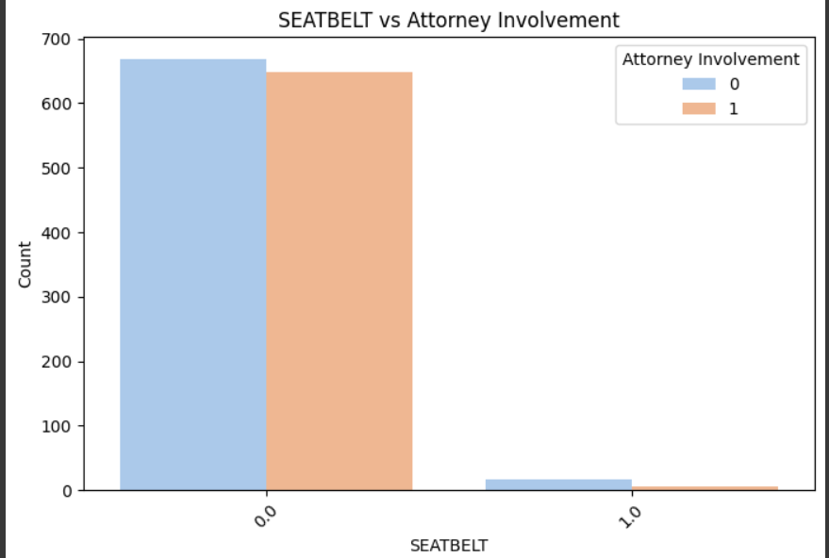
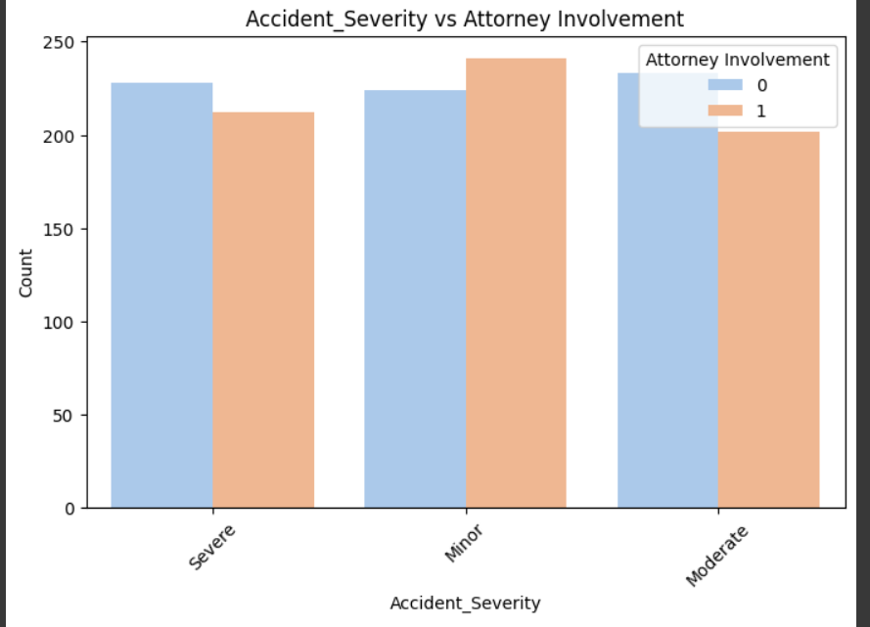

Slide 19
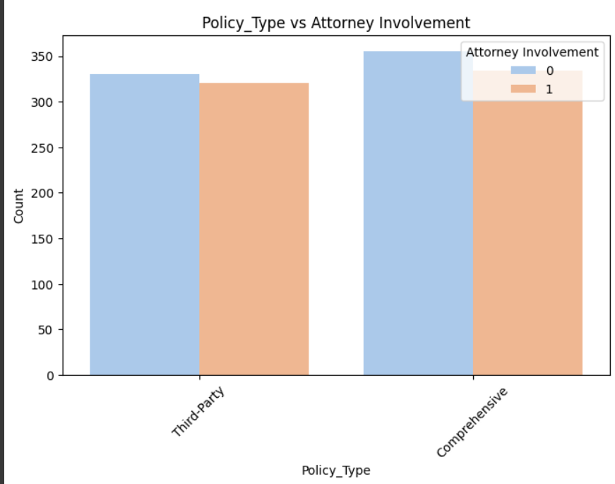
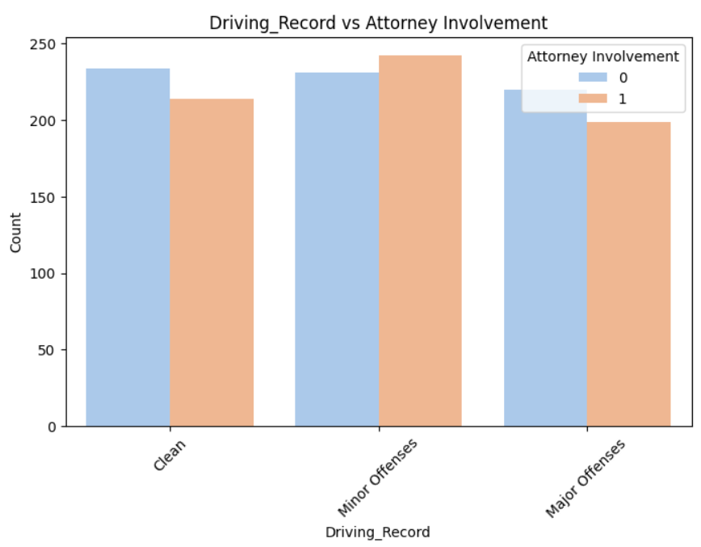

Slide 20
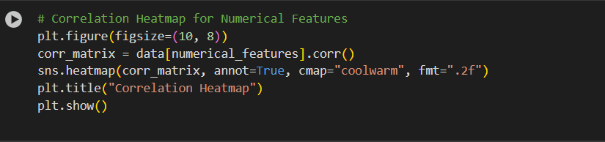
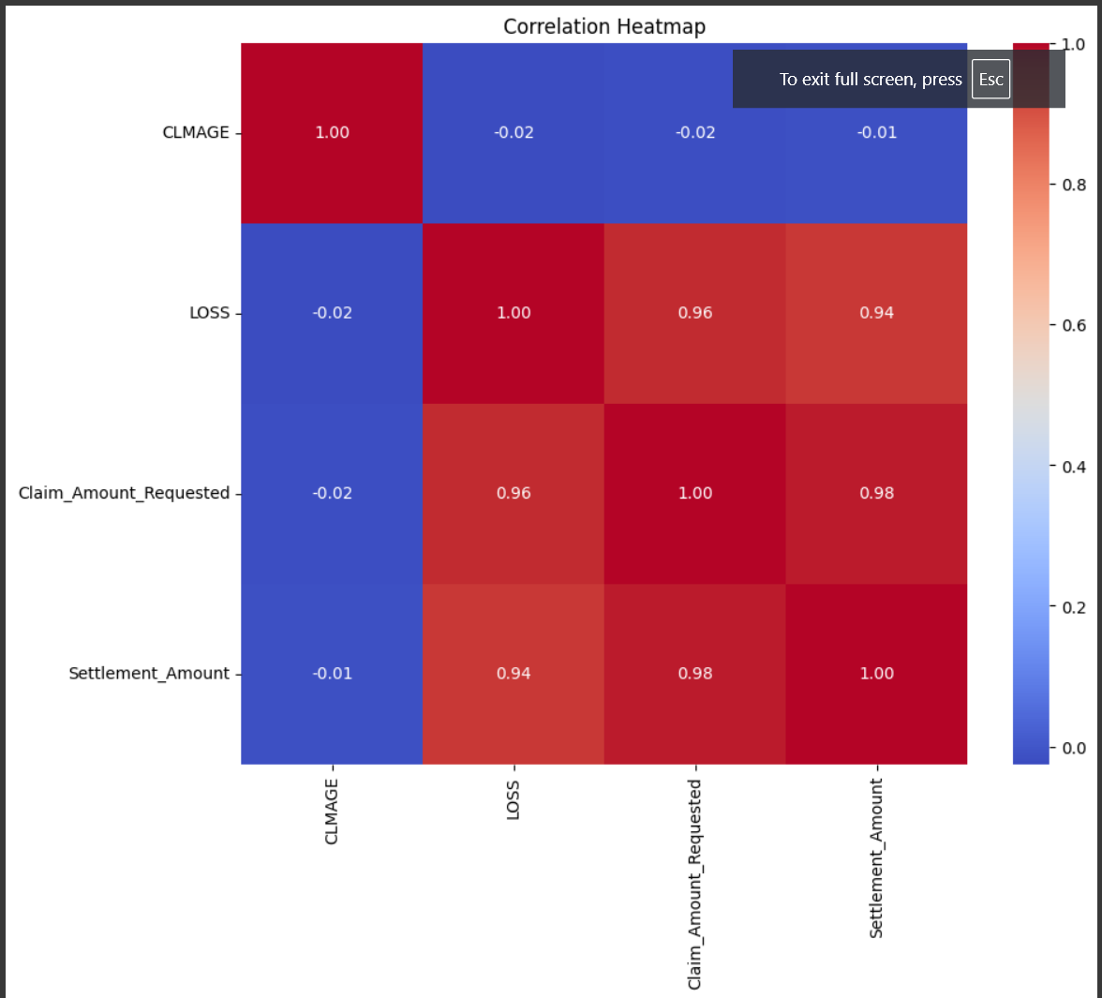

Slide 21
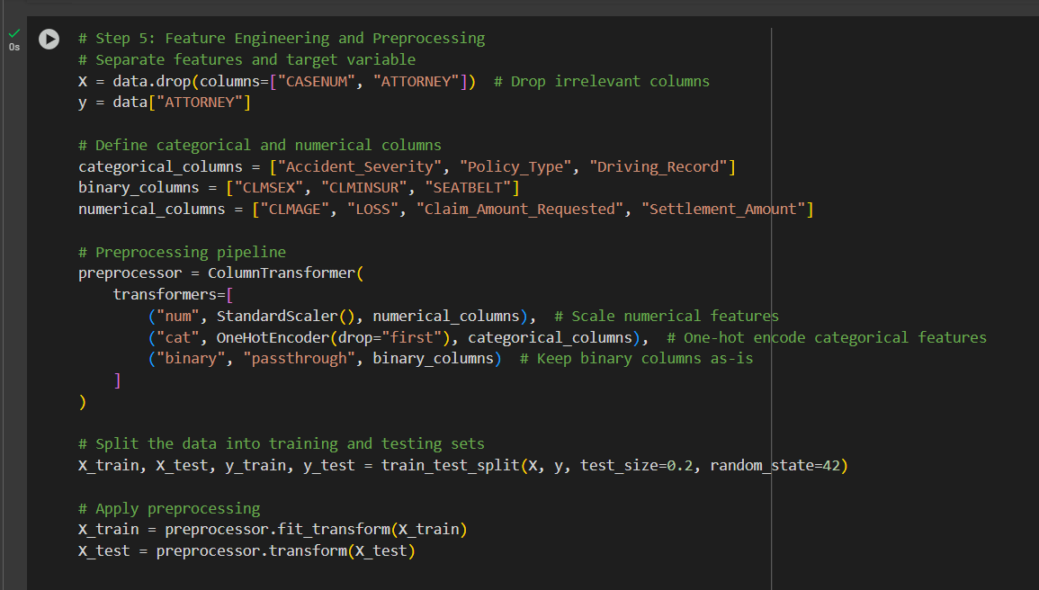
Feature Engineering And Preprocessing

Slide 22
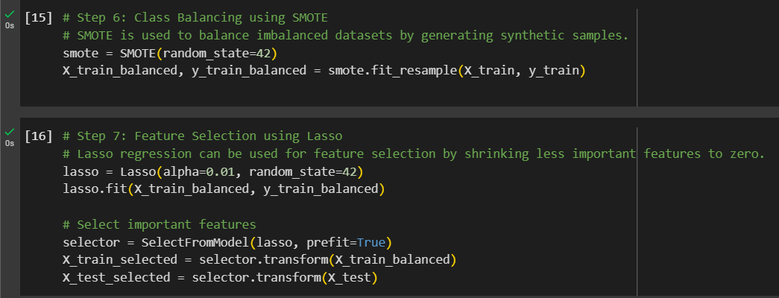

Slide 23
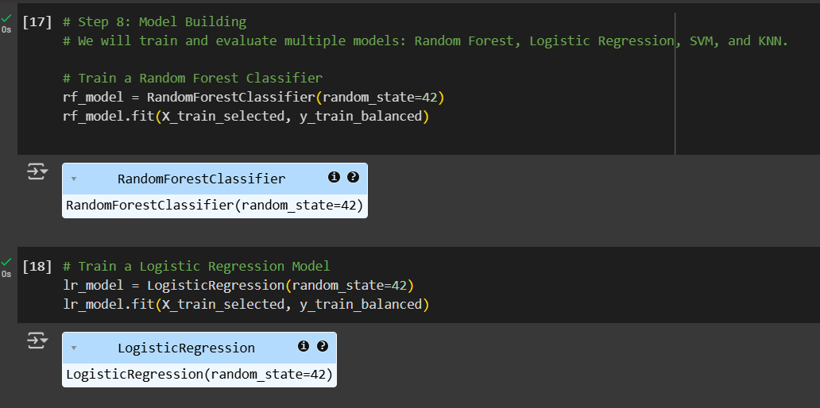
Model Building

Slide 24
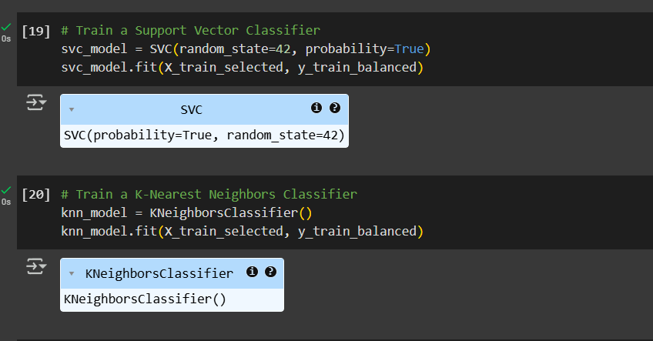

Slide 25
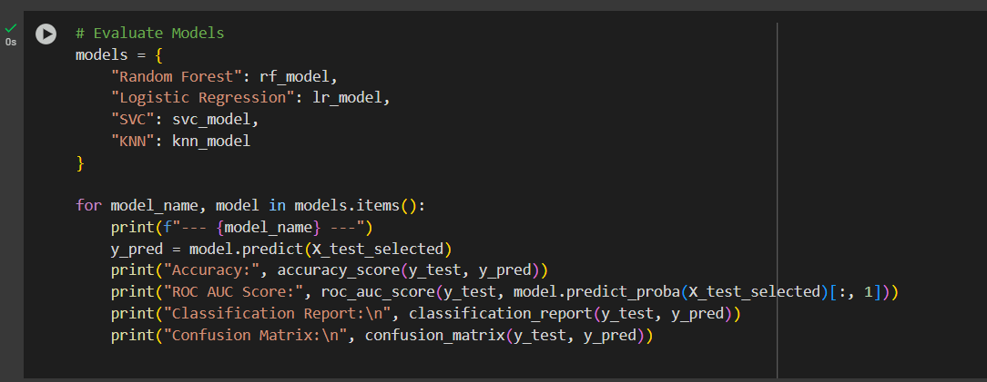
Model Evaluation

Slide 26
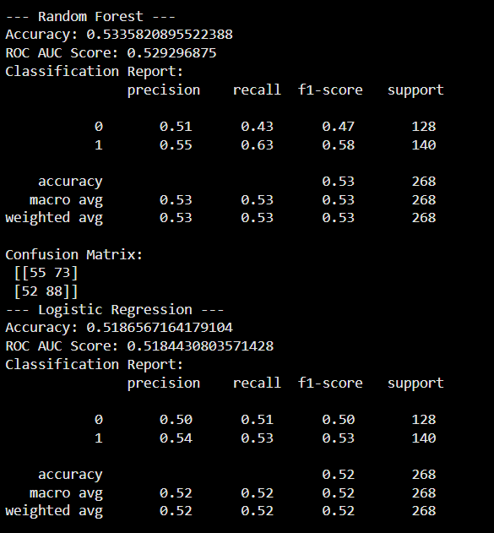
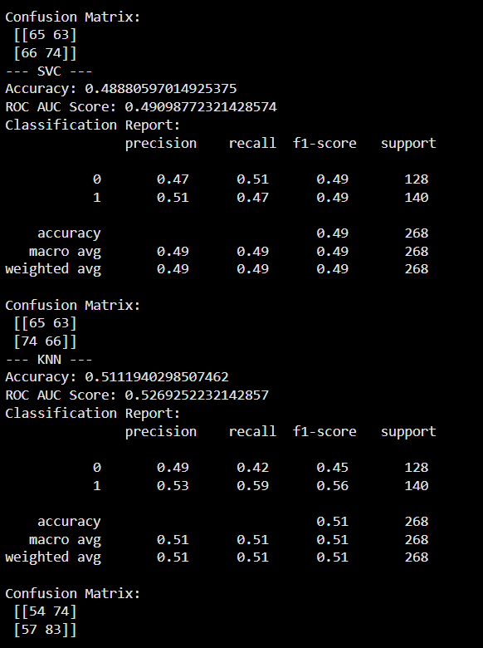

Slide 27
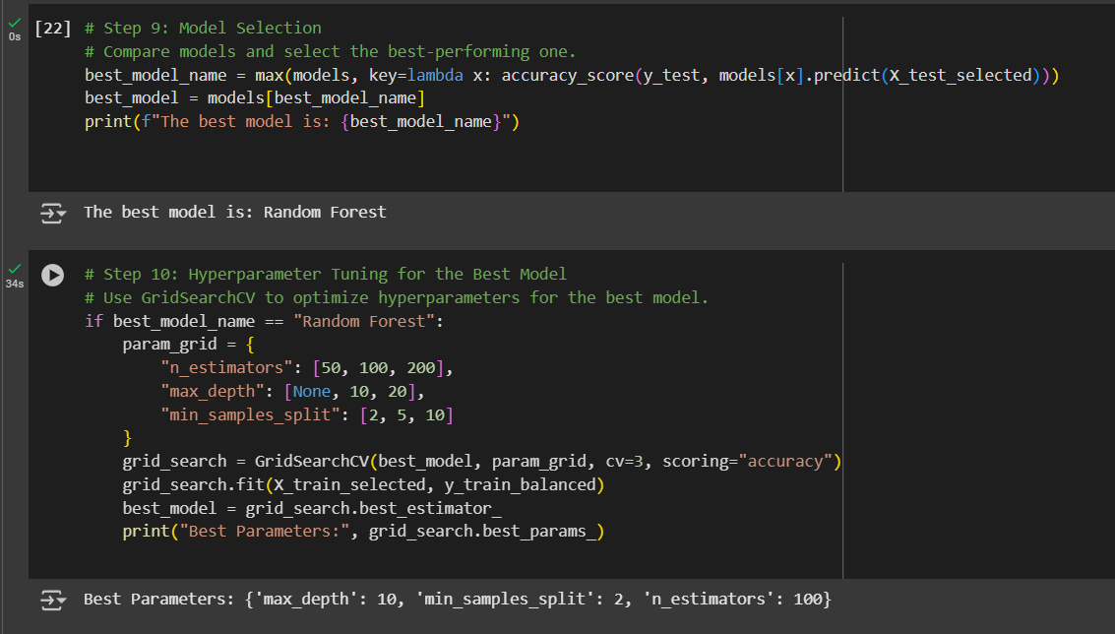

Slide 28
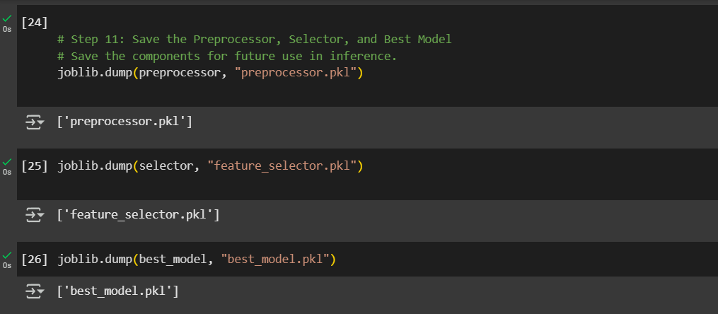

Slide 29
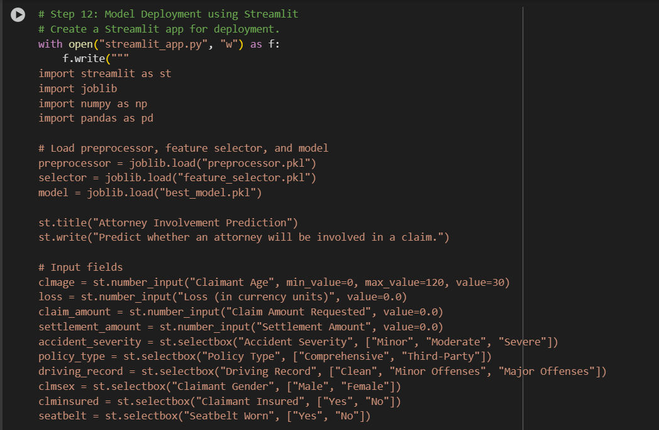
Model Deployment

Slide 30
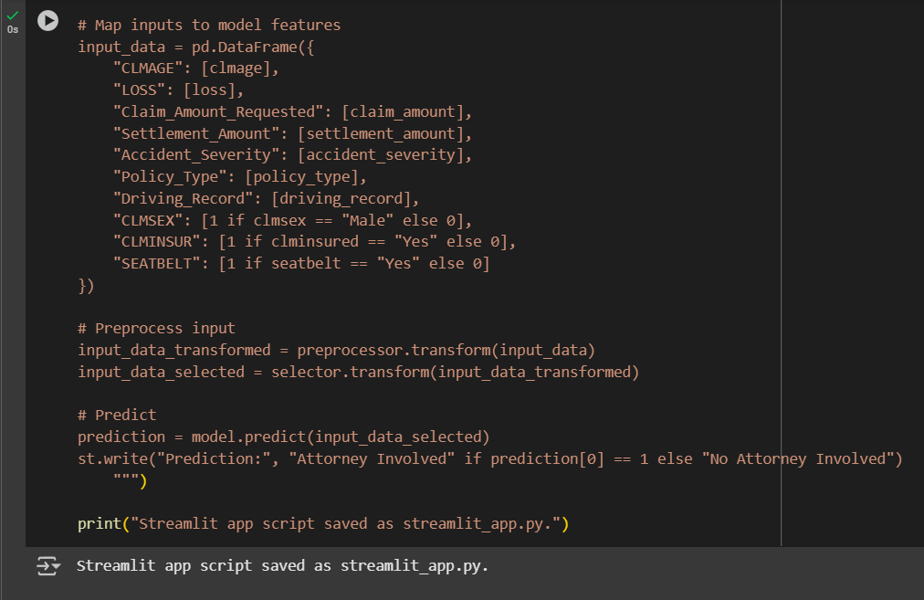

Slide 31
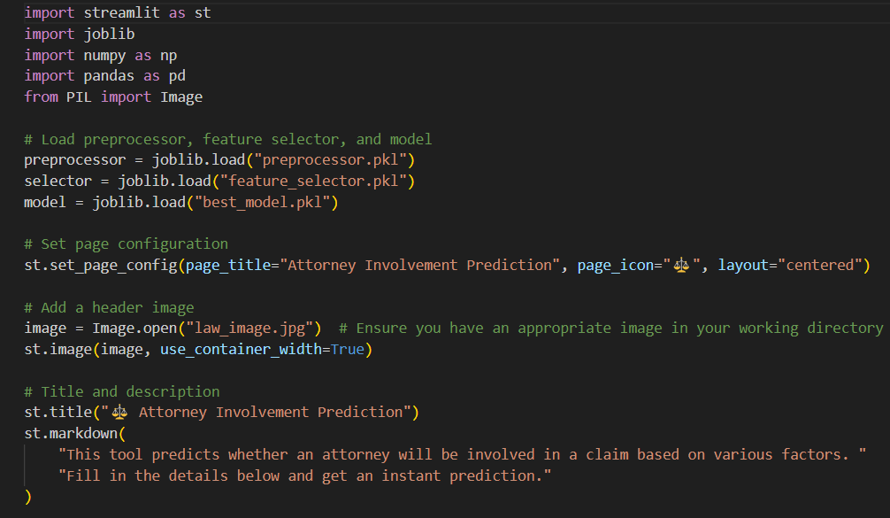
Deployment

Slide 32
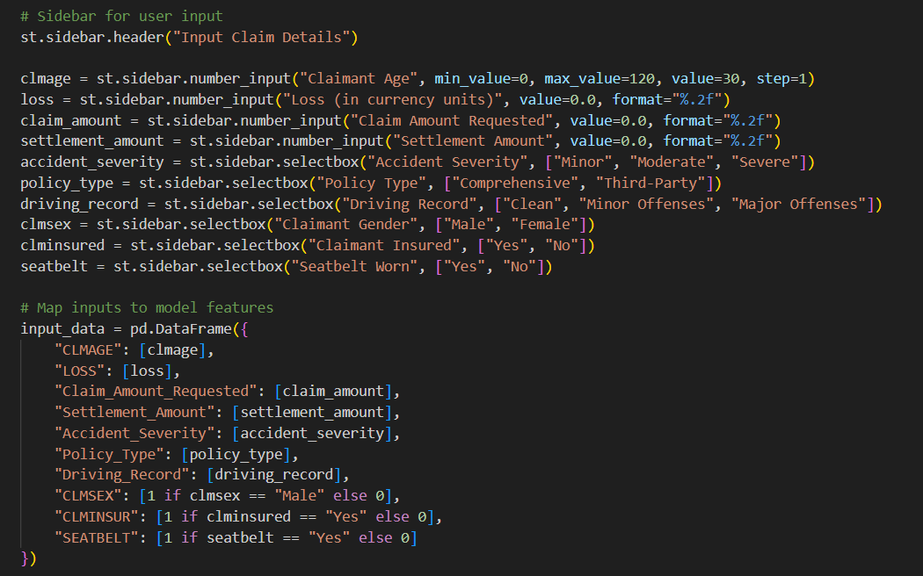

Slide 33
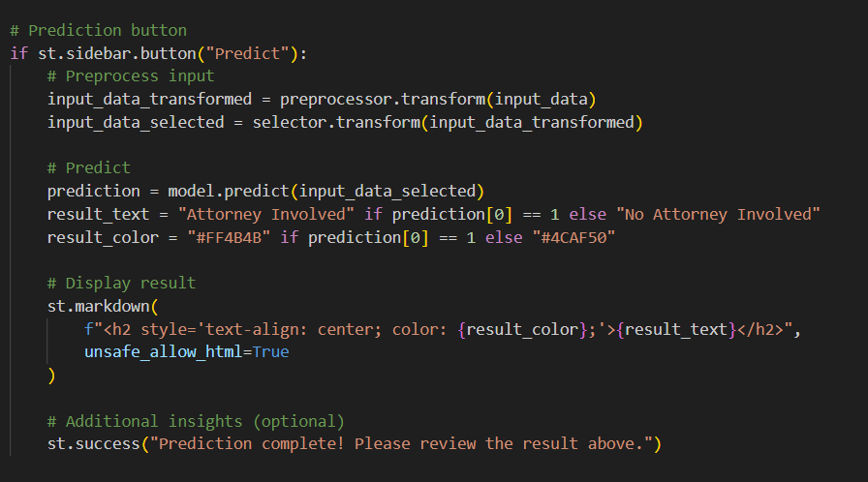

Slide 34
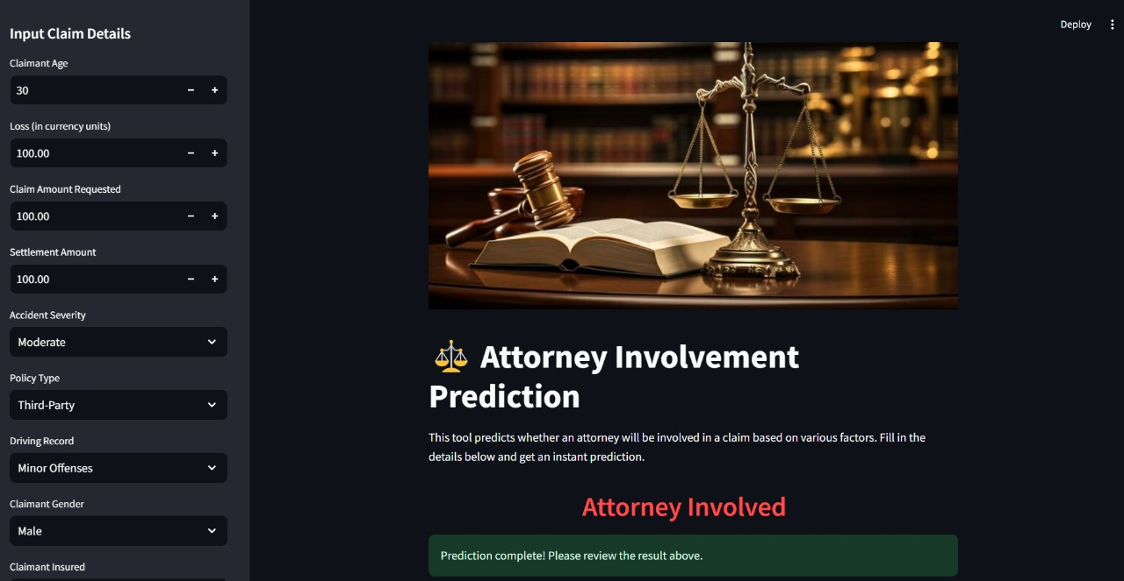

Slide 35
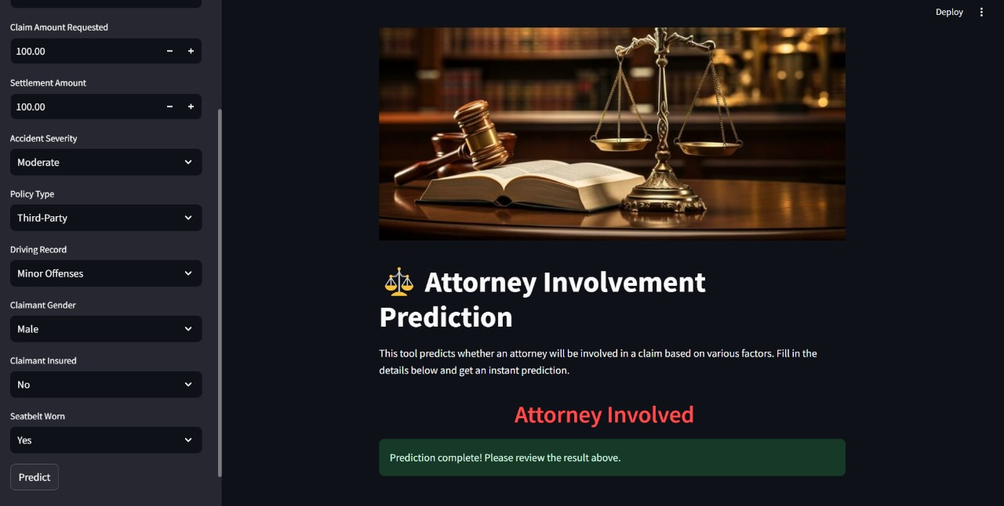

Slide 36
THANK YOU
PROJECT BY
KALYANI DADASAHEB PAWAR
THOTA ESHWAR
AMANDEEP
SHAIK YASMEEN
JITHIN BABU
TANAAZ SHARMIN
KAPARTHI MANI TEJA

